Slide 1
Windows

Slide 2
INTRODUCTION

Slide 3
“A Computer is an electronic machine that can solve different problems, process data, store & retrieve data and perform calculations faster and efficiently than humans”.
Computer consists of basically 2 parts:
Software
Hardware

Slide 4
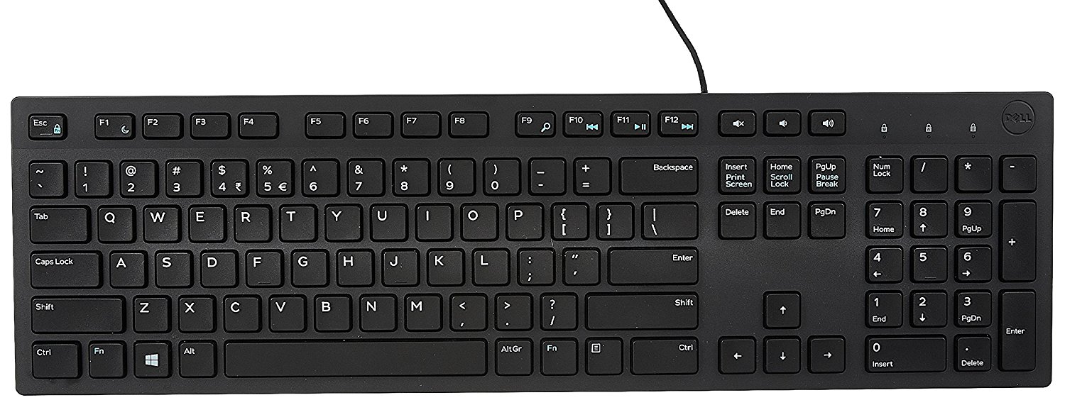
INPUT DEVICES
KEYBOARD
In computing, a computer keyboard is a typewriter-style device which uses an arrangement of buttons or keys to act as a mechanical lever or electronic switch.
Types
Mechanical Keyboard
Membrane Keyboard
Multimedia Keyboard

Slide 5
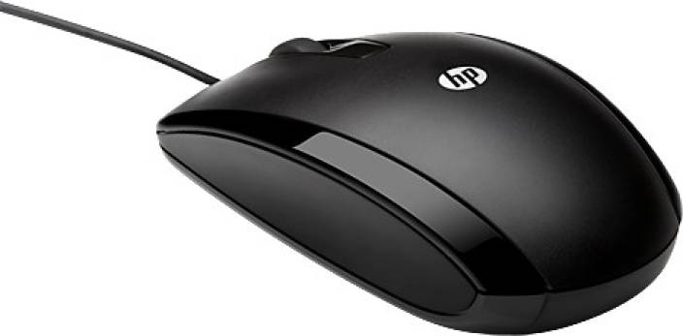
MOUSE
A computer mouse is a hand-held pointing device that detects two-dimensional motion relative to a surface.
Types
Mechanical mouse
Optical mouse

Slide 6
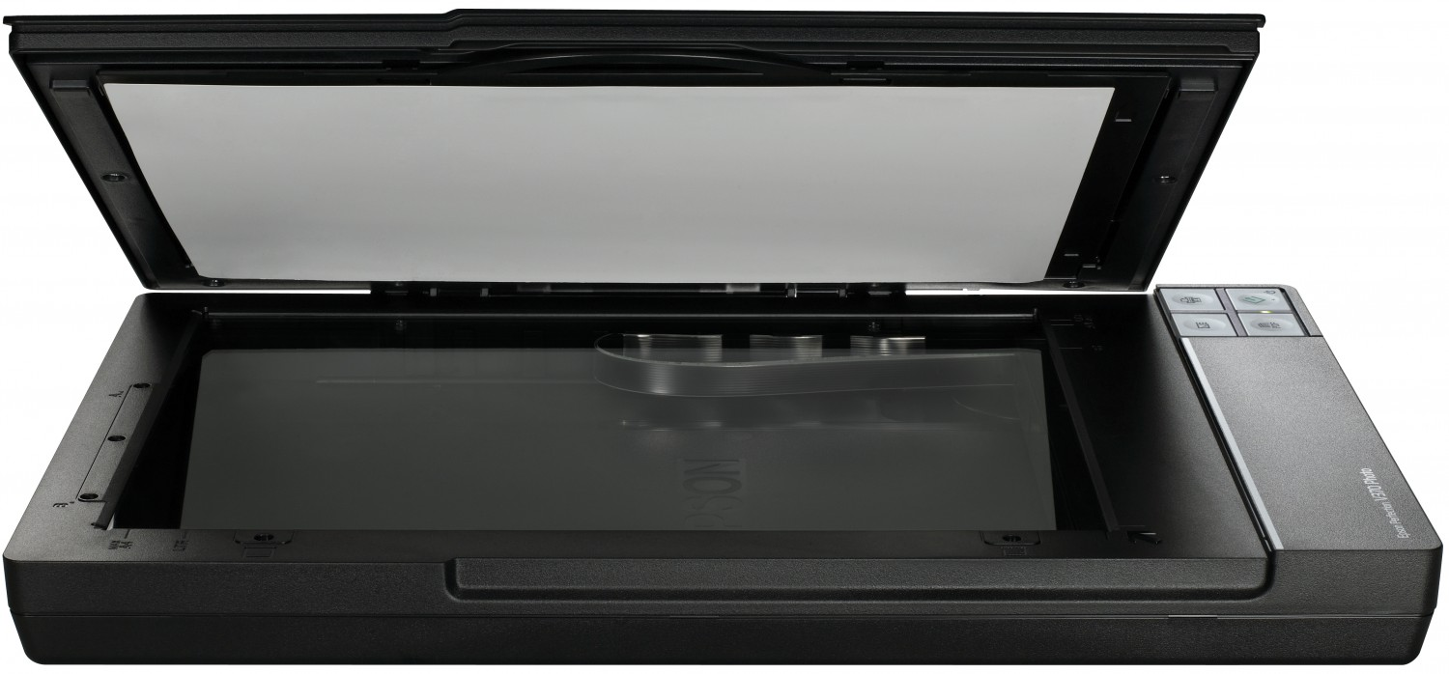
SCANNER
Scanner is a device that optically scans images, printed text, handwriting or an object and converts it to a digital image.
Types
Flatbed
Drum
Handheld
Sheet-fed

Slide 7
SMPS
Switched-Mode Power Supply (SMPS) is a power supply that uses a switching regulator to control and stabilize the output voltage by switching the load current on and off. These power supplies offer a greater power conversion and reduce the overall power loss.
blocks in SMPS. They are as follows:
Rectifier and filter
Chopper
Transformer (Step-down)
Feedback circuit

Slide 8
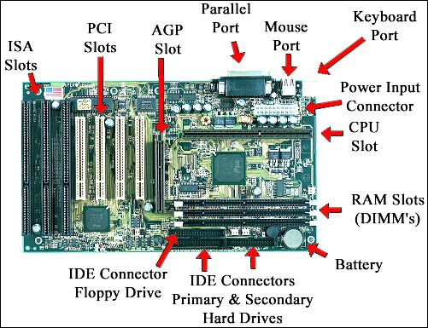
MOTHERBOARD

Slide 9
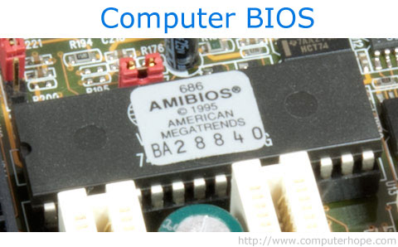
BIOS
Short for Basic Input/Output System, the BIOS (pronounced bye-oss) is a ROM chip found on motherboards that allows you to access and set up your computer system at the most basic level.
In the picture below, is an example of what a BIOS chip may look like on your computer motherboard. In this case, this is a picture of an early AMIBIOS, a type of BIOS manufactured by AMI.

Slide 10
RISC AND CISC
RISC | CISC
It stands for ‘Reduced Instruction Set Computer’ | It stands for ‘Complex Instruction Set Computer
smaller set of instructions | larger set of instructions
complex complier design. | an easy complier design.
The calculations are faster and precise. | The calculations are slow and precise.
Pipelining does function correctly. | Pipelining does not function correctly.

Slide 11
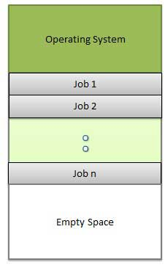

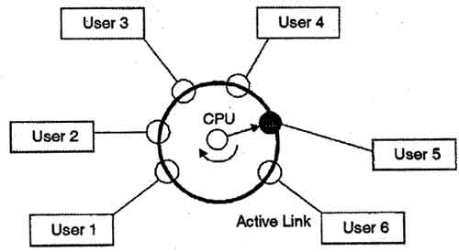

MULTIPROGRAMMING MULTITASKING
TIME SHARING MULTIPROCESSING

Slide 12
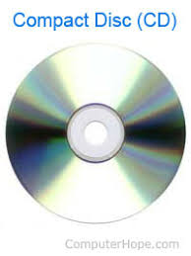
STORAGE
A storage device is any computing hardware that is used for storing, porting and extracting data files and objects.
There are two types of storage:
Magnetic Storage
Optical Storage

Slide 13
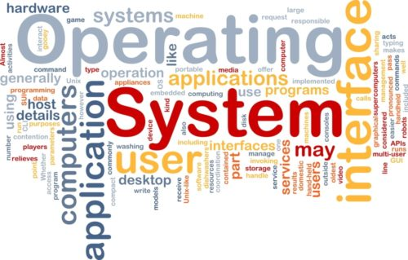
INTRODUCTION TO OS
Operating system (OS) manages all of the software
and hardware on the computer and provides
common services for computer programs
What is the need of OS?
An operating system is the most important
software that runs on a computer. It manages
the computer's memory and processes, as well
as all of its software and hardware. It also allows
you to communicate with the computer without
knowing how to speak the computer's language.

Slide 14
ADVANTAGES OF USING WINDOWS:
Ease of use.
Available software
Plug & Play
DISADVANTAGES OF USING WINDOWS:
Viruses
Price
security

Slide 15
FEATURES OF WINDOWS 7
Blue Ray disc support
XP mode
Fast booting
Support Touch, Speech, Handwriting recognition
.themepack
Bitlocker

Slide 16
TYPES OF KERNEL
Monolithic Kernel
Microkernel
Hybrid Kernel

Slide 17
ARCHITECTURE OF KERNEL

Slide 18
Win32 Application
Local Security Authentication
Security Account Manager
Win32 Subsystem
Win32k.sys
User Mode
Kernel Mode
Executive Services
I/O Manager
PowerManager
Security Ref. M
Config.
Manag
Process &Thread
Object
Manager
Process
Thread
Memory
Manager
LPC
Plug & Play M
KTM
Cache Management
Kernel
Windows Manager
File System
HAL
GDI
Network Driver
Graphics Driver
Device Driver
Hardware

Slide 19
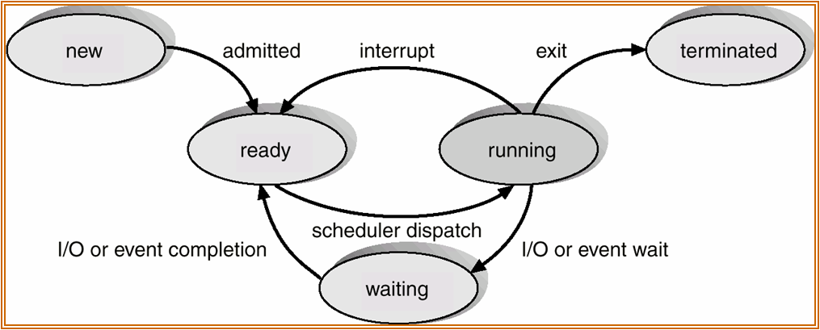
PROCESS
A process is an instance of a program running in a computer

Slide 20
PROCESSING TYPES
Multiprocessing : Multiple processor
Multitasking : Time sharing
Multithreading : Multiple threads
Hyper threading : single microprocessor to act like two separate processors

Slide 21
BOOTING PROCESS IN WINDOWS

Slide 22
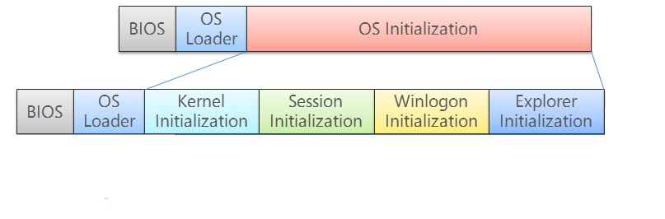
BOOTING PROCESS IN WINDOWS

Slide 23
BIOS
SMPS
PROCESSOR
BIOS
MBR
Boot Sector

Slide 24
OS LOADER
Boot Sector
Boot MGR
Winload.exe
NTOS Kernal
Kernal initialization

Slide 25
SESSION INITIALIZATION
SMSS.exe
CSRSS.exe
Wininit.exe
Winlogon.exe
Login UI.exe

Slide 26
EXPLORER INITIALIZATION
Logon UI.exe
Loads registry
Desktop window manager
Explores.exe
Initiates users
HKCU
dwm.exe
Userinit.exe

Slide 27
WINDOWS FILE SYSTEM

Slide 28
FILE SYSTEM
File
File is collection information that is recorded on secondary storage such as magnetic tapes and optical disks.
File system
File system is the way in which files are named and where they are placed logically for storage and retrieval.
History
In 1977 Microsoft developed file system known as FAT.
As size of storage devices increases NTFS came into existence.

Slide 29
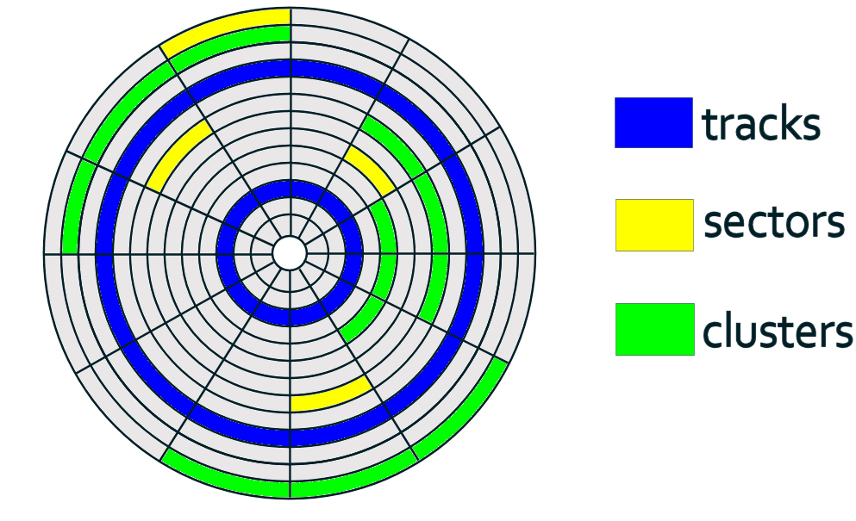
HARD DISC DRIVE STRUCTURE

Slide 30
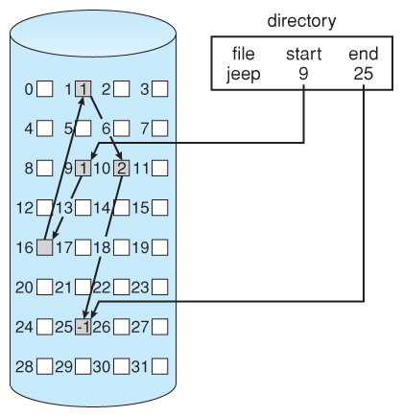
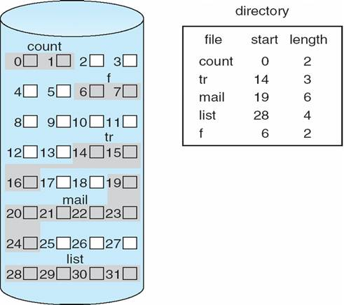
DATA BLOCK ALLOCATION
Contiguous
linked
Memory allocation
Memory allocation

Slide 31
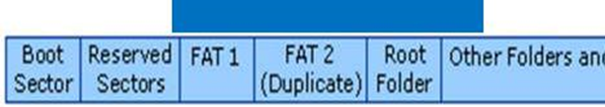
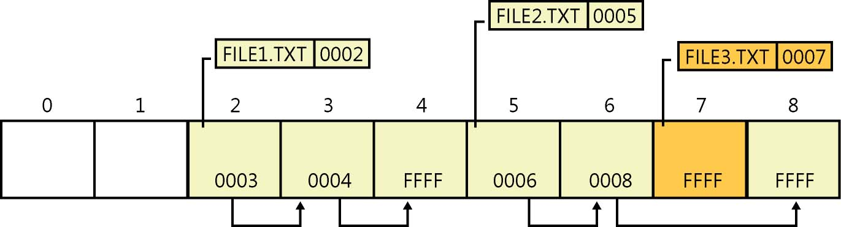
FAT 32

Slide 32
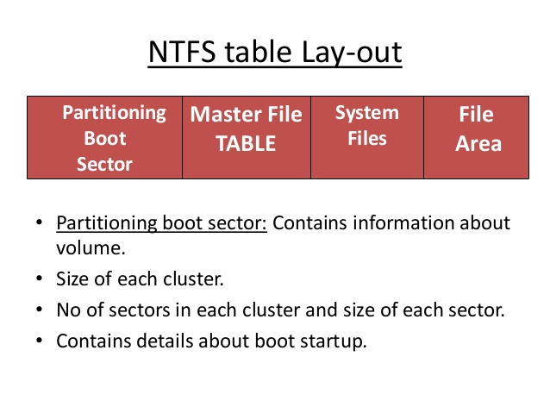
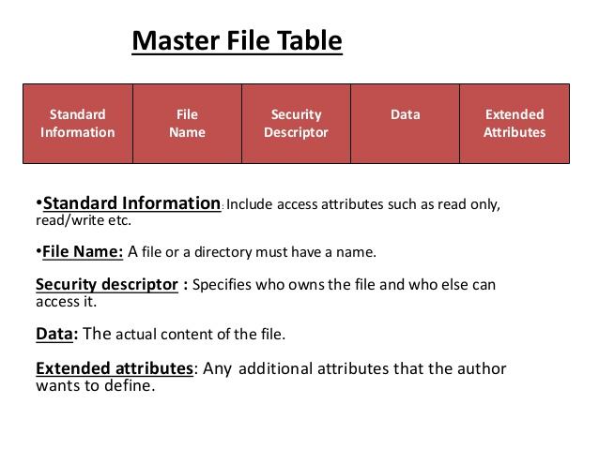
NTFS
Master file table

Slide 33
ADVANTAGES OF NTFS OVER FAT
Recoverability
Avaibility
Journaling
Security
Compression
Encryption

Slide 34
DEVICE DRIVER
A device driver is a program that controls a particular type of device that is attached to your computer.
Kernel Space
User space

Slide 35
MEMORY MANAGEMENT

Slide 36
PAGING
In computer operating systems, paging is a memory management scheme by which a computer stores and retrieves data from secondary storage for use in main memory. In this scheme, the operating system retrieves data from secondary storage in same-size blocks called pages.

Slide 37
THRASHING
Thrashing is computer activity that makes little or no progress, usually because memory or other resources have become exhausted or too limited to perform needed operations. When this happens, a pattern typically develops in which a request is made of the operating system by a process or program, the operating system tries to find resources by taking them from some other process, which in turn makes new requests that can't be satisfied.

Slide 38
FRAGMENTATION
As processes are loaded and removed from memory, the free memory space is broken into little pieces. It happens after sometimes that processes cannot be allocated to memory blocks considering their small size and memory blocks remains unused. This problem is known as Fragmentation.
Fragmentation is of two types −
External fragmentation
Total memory space is enough to satisfy a request or to reside a process in it, but it is not contiguous, so it cannot be used.
Internal fragmentation
Memory block assigned to process is bigger. Some portion of memory is left unused, as it cannot be used by another process.

Slide 39
MEMORY POOL AND ITS TYPES
The memory manager creates the following memory pools that the system uses to allocate memory: nonpaged pool and paged pool.
The nonpaged pool consists of virtual memory addresses that are guaranteed to reside in physical memory as long as the corresponding kernel objects are allocated.
The paged pool consists of virtual memory that can be paged in and out of the system. To improve performance, systems with a single processor have three paged pools, and multiprocessor systems have five paged pools.

Slide 40
Thank you

